Slide 1
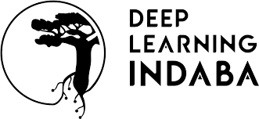

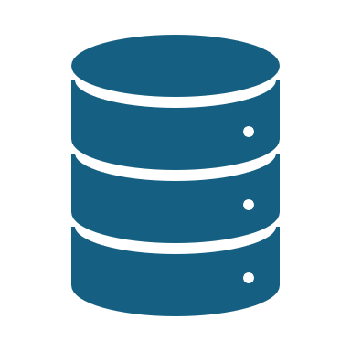

Python Fundamentals for Data Science
Presented by Praise Amonye
(Data Scientist/ML Research)
November 2024

Slide 2

Why Python for Data Science?
Python’s simplicity and readability.
Extensive libraries for data analysis, visualization, and machine learning.
Large community support.

Slide 3
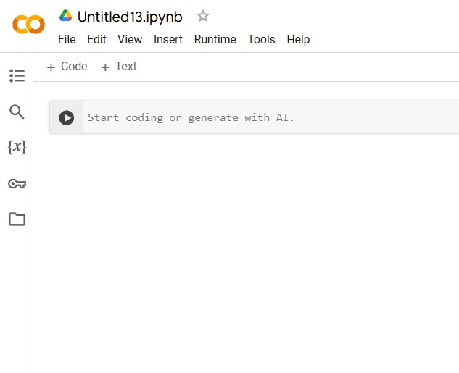
Setting up Python
Installation:
Direct Installation or using Anaconda.
Integrated Development Environment (IDE) Options:
Jupyter Notebook, PyCharm, Visual Studio Code, Google Colab.
Google Colab: A cloud-based Jupyter Notebook by Google allows users to run Python code in a browser without local setup.
- Cloud computing and collaborative co-working.
- Most used by data scientists

Slide 4
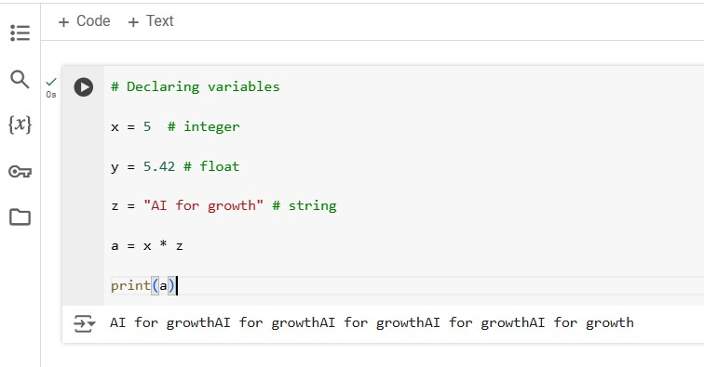
Basic Python Syntax
Data Types and Variables:
- Integers, Floats, Strings, and Booleans.
- Examples of declaring variables and simple operations.

Slide 5
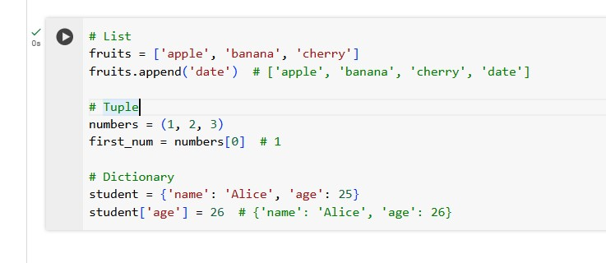
Basic Python Syntax Cont.
Lists, Tuples, and Dictionaries:
List: Ordered, mutable sequence “[ ]”
Tuple: Ordered, immutable sequence “( )”
Dictionary: Unordered, mutable mapping of keys to values “{key: value}”
Boolean: Ordered, immutable sequence “True or False”

Slide 6

Basic Python Syntax Cont.
Conditionals and Loops:
- if, else, elif statements.
- for and while loops.
Functions:
- Functions are defined using the def() command
- Used for organizing code.
- Used to prevent the need for iteration.

Slide 7

Any Question So Far?

Slide 8
Working with Libraries
KEY LIBRARIES FOR DATA SCIENCE:
NumPy: Used for numerical computations and array operations.
Pandas: Used for data manipulation and analysis.
Matplotlib and Seaborn: Mainly used for data visualization

Slide 9
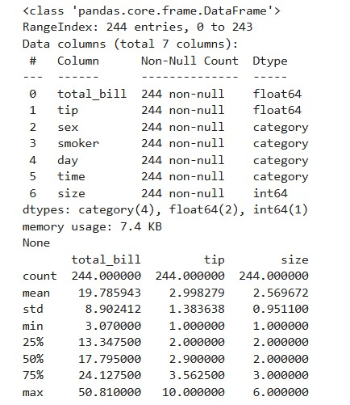
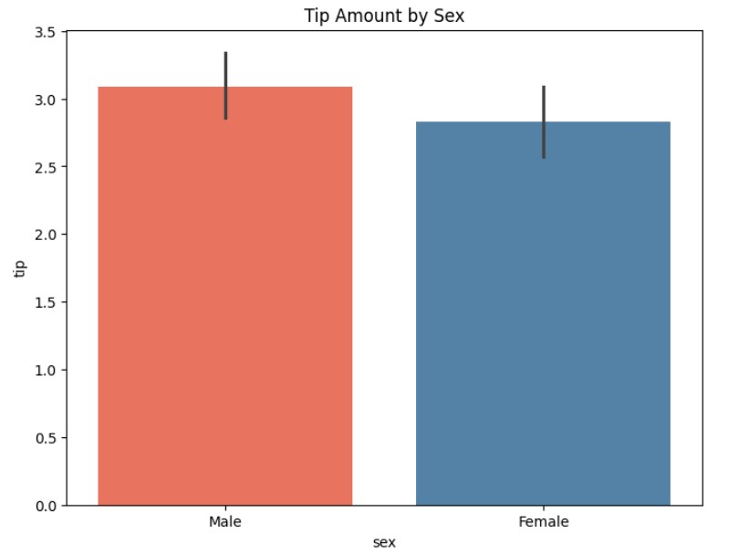
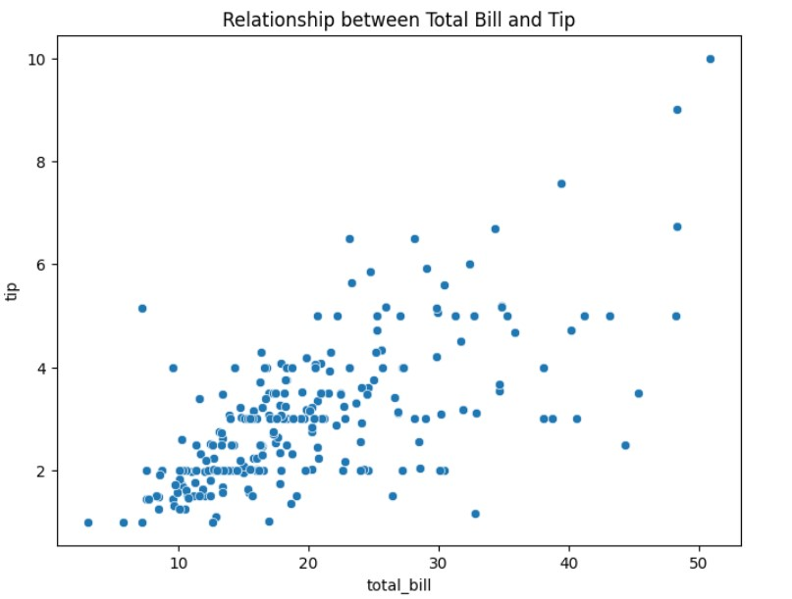
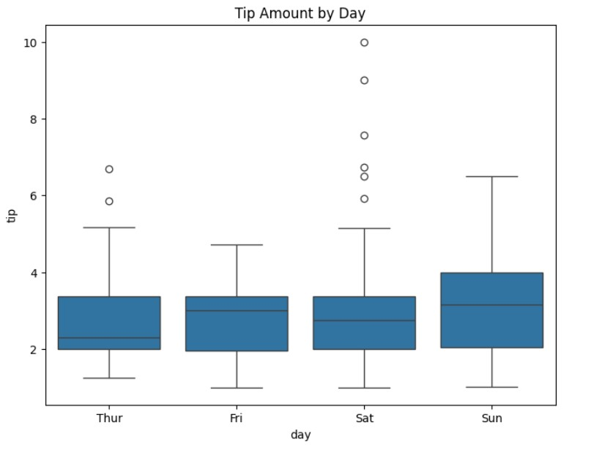
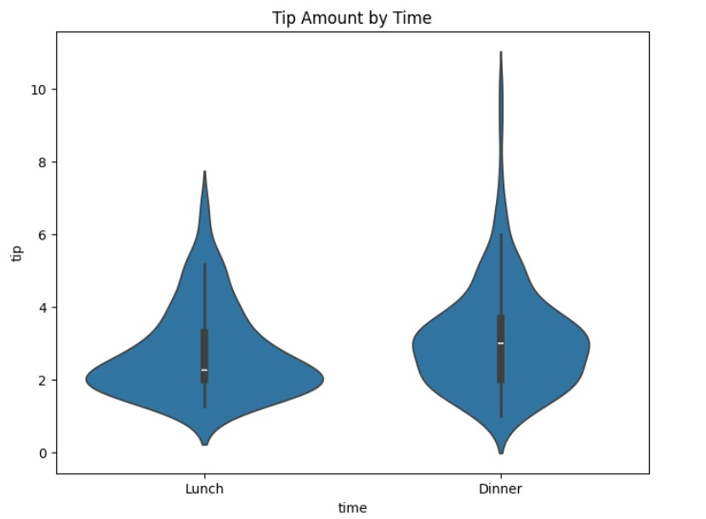
Working with Libraries Cont.
Hands-On Example

Slide 10

Data Science Workflow in Python
Data Collection:
- Importing data from CSVs, Excel files, or databases.
Exploratory Data Analysis (EDA):
- Using descriptive statistics and visuals to understand data patterns.
Data Cleaning and Preprocessing:
- Handling missing values.
- Filtering and transforming data.
- Accessing data types and structure

Slide 11
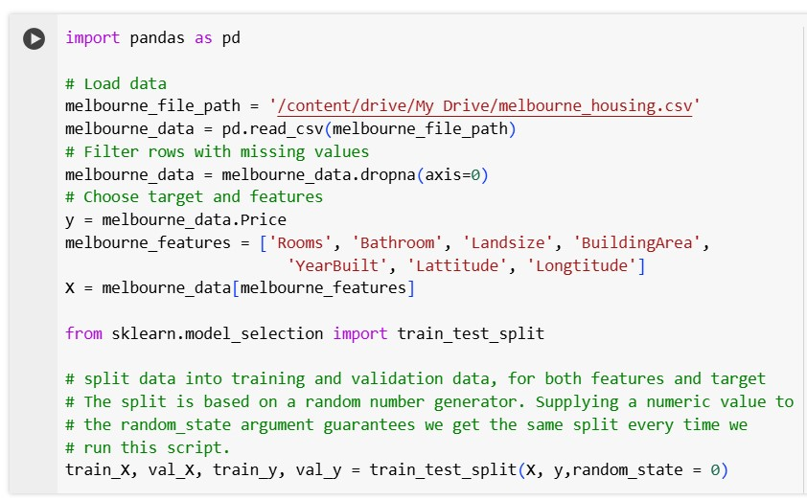
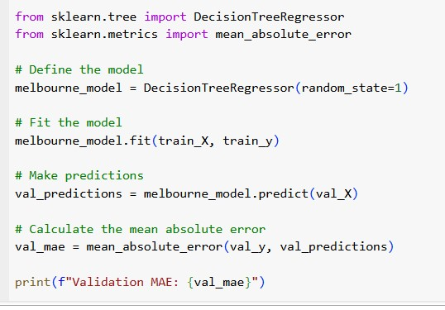
Introduction to Machine Learning in Python
Scikit-Learn: Important in building and evaluating ML models.
Basic Example:

Slide 12
Best Practices for Writing Python Code
Code readability and use of comments.
Using virtual environments.
Handling exceptions and debugging techniques.

Slide 13

In Conclusion
Python is very important for data science.
Python is the building block of data science
- Ready to learn?

Slide 14
Resources for Further Learning
Documentation: Python, NumPy, Pandas, Matplotlib, Seaborn.
Online Courses: Coursera, edX, DataCamp, or free resources like Kaggle.
Community: Stack Overflow, Zindi Python community forums.

Slide 15
Thank you for listening!

Slide 16

Q&A

